Slide 1
DAB 103 aNAlytic Tools & Decision Making: Project
GROUP – 008
SECTION - 003

Slide 2
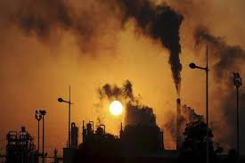
Project Proposal, Descriptive Statistics and EDA of Air Quality in India data from 2015 to 2020
https://www.google.com/imgres?imgurl=https%3A%2F%2Fimages.financialexpress.com%2F2020%2F02%2Fpollution.jpg&imgrefurl=https%3A%2F%2Fwww.financialexpress.com%2Flifestyle%2Fscience%2Findian-cities-most-polluted-in-the-world-carry-highest-level-of-deadly-micro-pollutants%2F1878723%2F&tbnid=n8ZX8YDLEHBZjM&vet=12ahUKEwj76ueWuIHyAhXXwqACHQlXDbgQMygoegUIARCHAg..i&docid=zC-J1Evh9Oz79M&w=660&h=440&q=air%20pollution%20in%20indian%20cities&hl=en-GB&ved=2ahUKEwj76ueWuIHyAhXXwqACHQlXDbgQMygoegUIARCHAg

Slide 3





Team Members
Kiranbir Kaur
Harbans Kaur
Navjot Kaur
Jyoti Bala
Jasvinder Kaur

Slide 4
Background/Motivation :
“Air pollution is defined as the presence of pollutants in the atmosphere that are damaging to human and other living species' health, as well as to the climate and materials. Gases (such as ammonia, carbon monoxide, Sulphur dioxide, nitrous oxides, methane, and chlorofluorocarbons) and particles (such as pollen) are all examples of air pollution (both organic and inorganic).”[1]
https://en.wikipedia.org/wiki/Air_pollution
Our team motive is that we want to analysis which gas is more harmful and effect environment and human beings

Slide 5
Project Proposal:
We will create a descriptive analysis.
We'll figure out which cities have the worst air pollution, which will assist raise awareness and encourage the government to take action to address the problem. That issue should be regulated by high authorities.
Our team has decided to examine or analyses the air quality index (AQI) of various cities. We'll look at a variety of factors to see how many explanations there are in different cities and states. Our team will perform a descriptive analysis to establish which causes contributed to the greatest pollution and where it happened.

Slide 6
Problem Statement
Today, more than 70000 people are facing breathing and lungs problems due to inhaling toxic air which not only harmful to body but its is major reason to increase temperature(global warming)
We can analysis which are the main reasons that are create this problem like incrimination, landfilling and cutting trees.
We can examine in which region, state and city of India now more polluted. And we can Monitoring it and understanding its quality is of immense importance to our well-being.

Slide 7
Objectives:
Our team's objective is to find out the air quality in each region and the states and cities in India. We want to investigate which toxic gas is dangerous and how it affects weather conditions.
We will also make comparisons between the various variables in order to thoroughly analyze the data set for specific years (2010-2020).
We will also conclude this because of Covid-19, how air pollution is reduced, and why. For example, public transportation is scarce.

Slide 8
Source of the dataset
The analysis will be based on for Air quality in Indian cities dataset obtained from Kaggle.
It contains the data from the year 2015 to 2020
The Link of the dataset:
https://www.kaggle.com/neomatrix369/air-quality-data-in-india-extended

Slide 9
Data description:
This file is available on "Kaggle" and the name of the dataset is "Air Quality Data in India Extended". In search a report on air pollution in India published by the Health Effects Institute in 2018, air pollution was associated for 1.1 million deaths in India in 2015. This dataset can be useful to prevent Air Pollution
There are a total of observations are 29531 and 16 features.

Slide 10
Schema Definition
Categorical Variables
Numerical Variables
Application Dataset
Example:,NO2,CO2, SO2,Nox,NH3,O3
Examples: year, season, AQI Bucket
station_day_transf-ormation: status, city,state,weekdays_or_weekends AQ_Acceptability etc.
Target Variable
Date,year,city,state,AQI Bucket,status,AQ_Accptability,season,weekdays and weekends airquilty.

Slide 11
Numeric and categorical variables
Variables | Description | Data types
City | It is a permanent and settled place with defined boundaries | object
NO2 | Nitrogen Dioxide | Float64
NOx | Nitrogen oxide | Float64
NH3 | Ammonia | Float64
CO | Carbon monoxide | Float64
SO2 | Sulphur Dioxide | Float64
O3 | Ozone | Float64

Slide 12
Benzene | Chemical compound | Float64
Toluene | Colourless and flammable liquid | Float64
Xylene | Xylol or dimethylbenzene | Float64
AQI | Air Quality Index | Float64
AQI bucket | For general public to know air quality | Object
Station ID | It is a practice of networks Identifying themselves on air | Object
StationName | Specifies the railway station | Object
State | Its territory, the area of geographical boundaries | Object
Region | It can be defined by natural or artificial features | Object
Month | A measurement of time | Object
Season | It is a period of a year that is distributed by special climate conditions | Object
Weekend | The end of the week | Object
AQ acceptability | To develop a multi-construct framework | Object
Year | A period of twelve months from any special date | Int64

Slide 13

Preliminary Visualizations

Slide 14
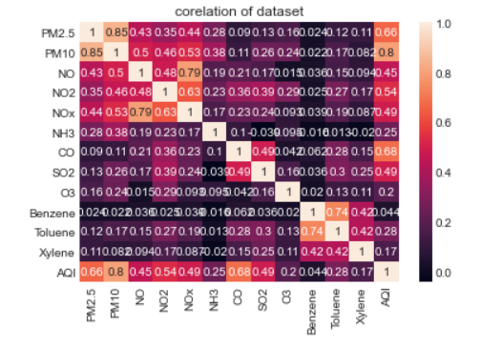
Correlation
Ques. Are some data elements highly corelated with each other?
Answer. Yes, from correlation table, it is clear that data few columns are highly correlated with each other and shows positive relationship.

Slide 15
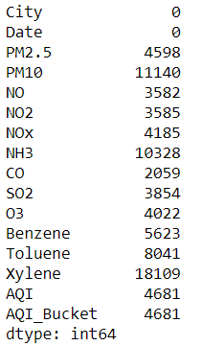
Missing and Invalid records of dataset
The Dataset contains less number of invalid records of column .Below mentioned is the number of null values for each column.

Slide 16
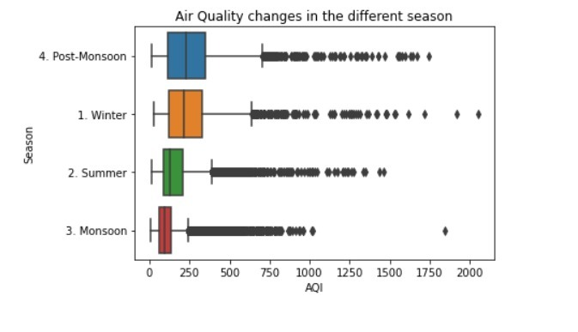
Does the data has any outliers?
From the below mentioned horizontal graph, it can be clearly seen that air quality changes due to different season and the points that are far away from the continuous points and lies between 1750 and 2000 AQI are outliers

Slide 17
QUES. Is the data imbalanced (large number of the records represent a majority class and very few records represent the minority class)?
Answer. There are few records in the dataset which are imbalanced, as the observations in each entity are either having incomplete or blank values. Furthermore, numerous columns, such as city and state with division in a maximum number of records represent a majority class, while a small number of records represent a minority class. For instance, in the below horizontal bar graph AQI level has different values in the each state of India.

Slide 18
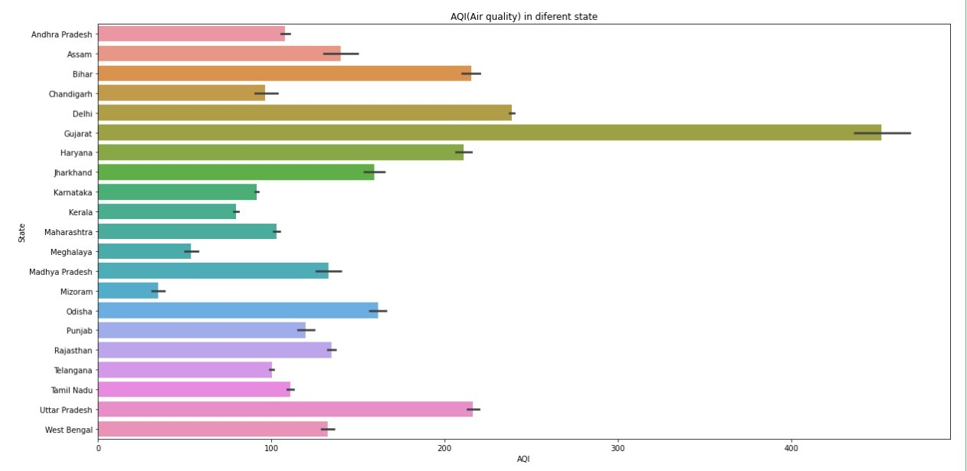
Example of imbalance data

Slide 19
Ques. What are the inclusion criteria for your data?
Answer. The following variables are the inclusion criteria for this dataset: AQI, AQI Bucket and many gases like NO,CO, NO2, NOx, O3,which are harmful for humans and environment as well.
Ques. Is the data segmented into groups?
Answer. Yes, the data is classified into groupings, for example, different regions are divided into cities and states.
Ques. Can you generate preliminary visualizations for individual features?
Answer. Yes, some preliminary graphics have been added to the slides.

Slide 20

Handling missing values
The dataset has a lot of missing values because a certain number of rows have small records and many missing or Nan values. Dealing with such values is an integral part of cleaning the data, which results in wrong decisions if not dealt with properly. Because these null rows have an impact on our predictions, we must remove them in order to improve our analysis experience.
https://i.ytimg.com/vi/IvVuncU5cmw/maxresdefault.jpg

Slide 21
Data Cleaning & transformation

Slide 22
Step 1. To check the null values “ .isnull().sum()” is used to check the total number of missing values in dataset
Step 2. “.dropna()” is used to check the total number of missing values in city_day,station_day and station_day_transformed dataframes
Step3: “ fill.na("unknown")” function is used for filling missing obrevations with world 'Unknown'
Step4: Then sort the data by date column and further divide into three columns as day, month and year
step5. To drop unwanted or unused columns(in station_day_tranformation dataframe, we deleted unnamed field and in city_day dataframe , date column is removed)

Slide 23
step6: Rename the columns as "NO": "NitricOxide", "NO2": "NitrogenDioxide", "NH3":"Ammonia", "CO":"CarbonDioxide","SO2":"SulfurDioxide“ and "O3":"Ozone"
Step7: “ pd.merge()” is used for merging sorted dataframes which will further used in tableau for visualization
Step8: .to_csv is used to load the dataframe to excel

Slide 24

Data cleaning
It is the process of making data fit for further analysis by correcting incomplete or invalid records from the dataset and then remove missing values by replacing, modifying or deleting the unusual data.
https://www.google.com/url?sa=i&url=https%3A%2F%2Fxaltius.tech%2Fwhy-is-data-cleaning-important%2F&psig=AOvVaw1RaSo-WKa0XXGjqGkj0Ff_&ust=1627382562077000&source=images&cd=vfe&ved=2ahUKEwiZs73NxoDyAhWR0nMBHe69CiQQjRx6BAgAEA8

Slide 25
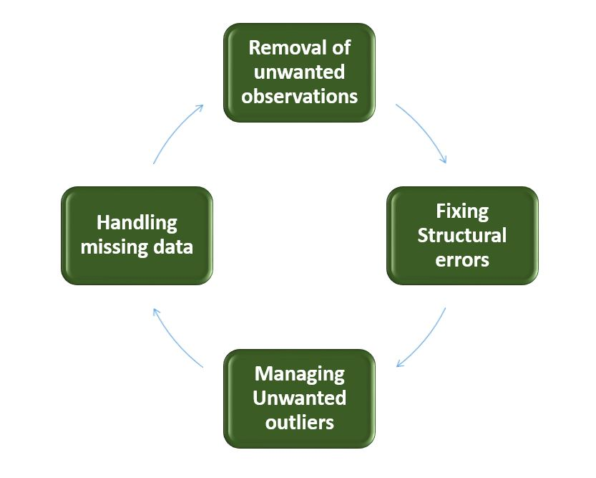
Data cleaning Process
https://images.app.goo.gl/rPDwbkckwBsoBYVk9

Slide 26
Change Column types
we discovered that several columns contain undesired data that isn't relevant in our analysis, and that some column names aren't proper or contain unwanted spaces. Using the Python package pandas, we may modify column names or remove unneeded columns.
In our dataset we made some changes by Renaming the column names as "NO": "NitricOxide", "NO2": "NitrogenDioxide", "NH3":"Ammonia", "CO":"CarbonDioxide","SO2":"SulfurDioxide“ and "O3":"Ozone"

Slide 27

Analysis questions
https://images.app.goo.gl/68tTHd3XXqAm8g2v6

Slide 28
Analysis questions
1.Which year the percentage of air pollution is high?
2. In which season the proportion of air pollution is less?
3. Grouping the CO by city and calculating the average CO per city?
4. In which city the average of NO gas is higher or lesser?
5. In which city the average of NO2 gas is higher or lesser?
6. In which State the average of NO gas is higher?
7. How various gases affect various regions?
8. The average of different gases in each city?
9. Air quality per year

Slide 29

Answering analysis questions

Slide 30
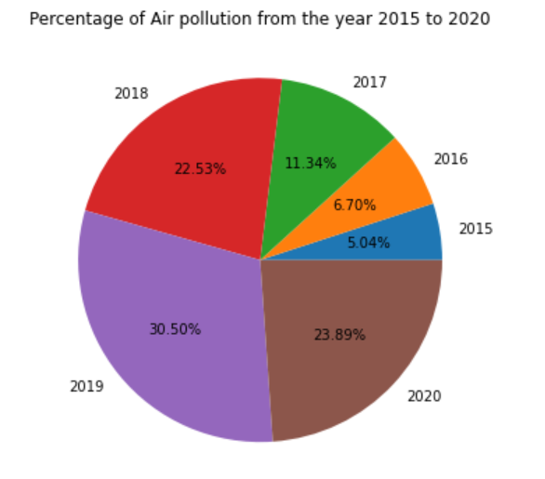
1. In Which year the percentage of air pollution is high?

Slide 31
Description of Pie-chart
In this pie chart, 2019 at peak point in the proportion of air pollution, which was 30.50% and represents by purple color. The rate of air pollution was quite less in 2015 and 2016,that was 5.04%-6.70%. Ratio of air pollution was mostly equal in the years of 2018 and 2020, it was approximately nearby a quarter whereas in 2017, this percentage was only 11.34%.

Slide 32
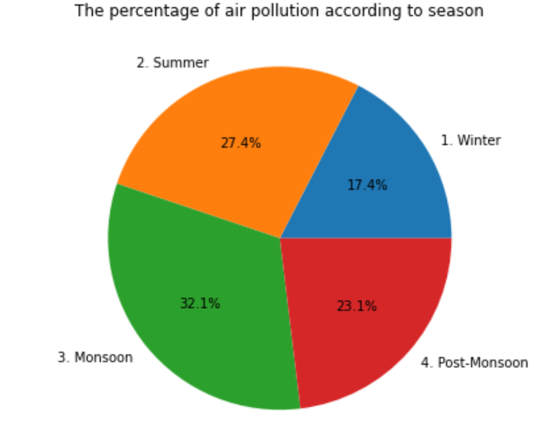
2. In which season the proportion of air pollution is less?

Slide 33
Description of pie chart 2
As can be seen from the pie chart, air pollution is much lower in the winter than in other seasons, at only 17.4 percent, although the ratio of air pollution in the monsoon is around 15% more than in the winter. Furthermore, the percentage of air pollution in the post-monsoon and summer seasons is roughly 23.1 percent -27.4 percent.

Slide 34
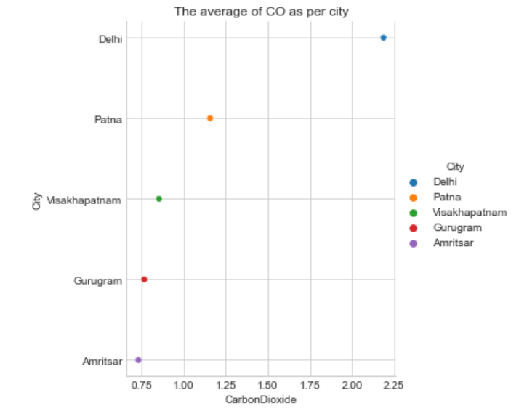
3. Grouping the CO by city and calculating the average CO per city?

Slide 35
Description of Graph3
The graph depicts the average CO per city, with Delhi coming in first with a value of around 2.25 and a dark blue color.
Furthermore, CO levels in Patna are less than 1.25, whereas CO levels in Gurugram and Amritsar are only 0.75, and CO levels in Delhi are also 0.75 and in Visakhapatnam are slightly higher than in both cities.

Slide 36
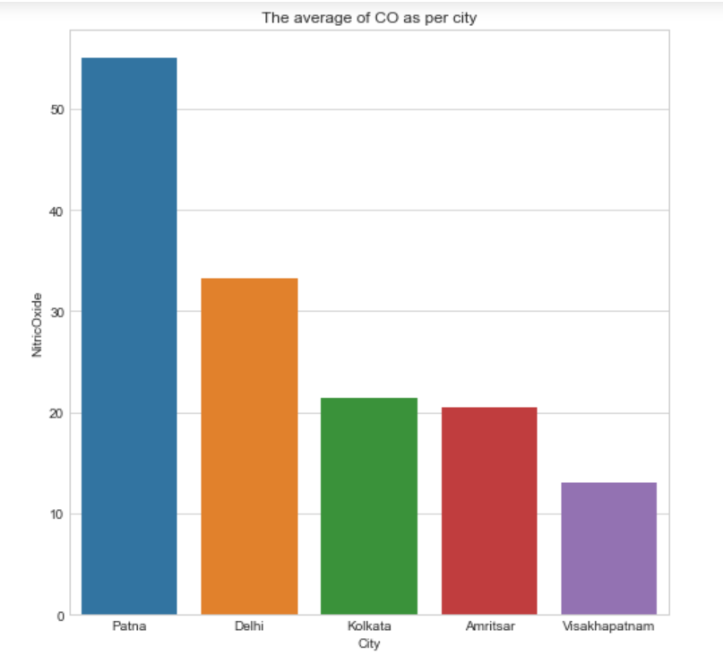
4. In which city the average of NO gas is higher or lesser?

Slide 37
Description Of Graph 4
This graph shows that amount of NO gas in Patna city is at the peak which is more than 50 whereas Vishakhapatnam is very low
which is near about 15. After that the ratio of NO gas in Kolkata and Amritsar are approximately similar which is about 20.
In the case of Delhi level of NO gas is 33.

Slide 38
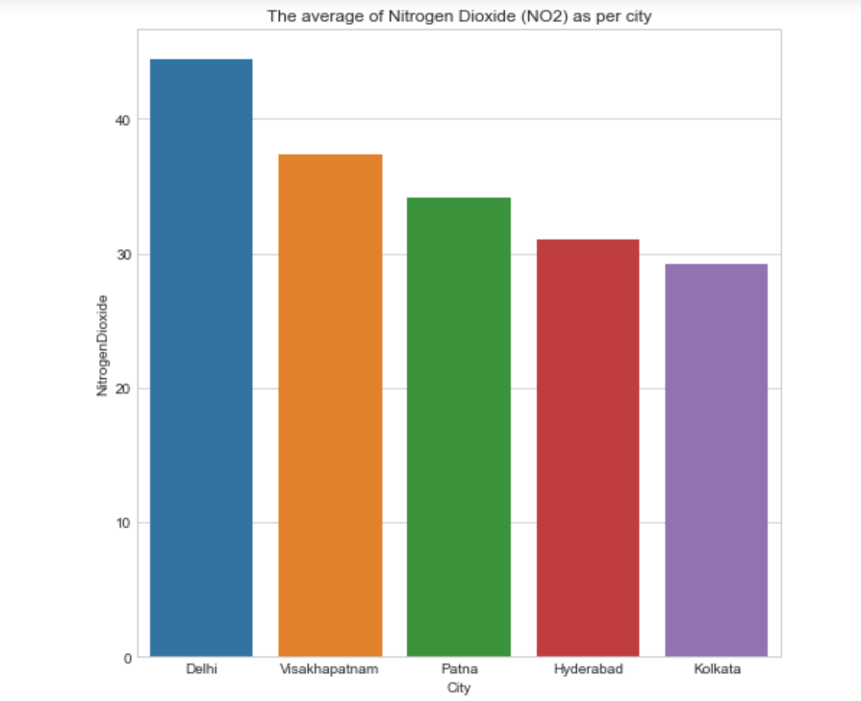
5. In which city the average of NO2 gas is higher or lesser?

Slide 39
Description of Graph 5
Delhi is ranked first in the average of NO2, which is shown by the color blue in the vertical bar graph.
In addition, Visakhapatnam is India's second-most populous city (NO2). In terms of NO2 average, Patna and Hyderabad are ranked fourth and fifth, respectively, but Kolkata ranks low in comparison to other cities. The graph depicts the average CO per city, with Delhi coming in first with a value of around 2.25 and a dark blue color.
Furthermore, CO levels in Patna are less than 1.25, whereas CO levels in Gurugram and Amritsar are only 0.75, and CO levels in Delhi are also 0.75.
in Visakhapatnam are slightly higher than in both cities.

Slide 40
Tableau Visualization

Slide 41
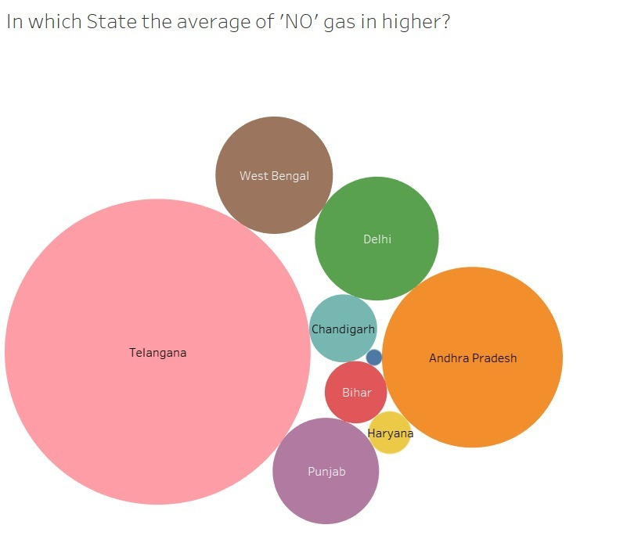
6. In which State the average of NO gas is higher?

Slide 42
Description
The average of NO city is shown in this image as a series of staes. Telangana has a higher average of NO than the rest of the states, whereas Chandigarh, Bihar, and Haryana have the lowest, and the other two states, West Bengal and Delhi, have about the same record.

Slide 43
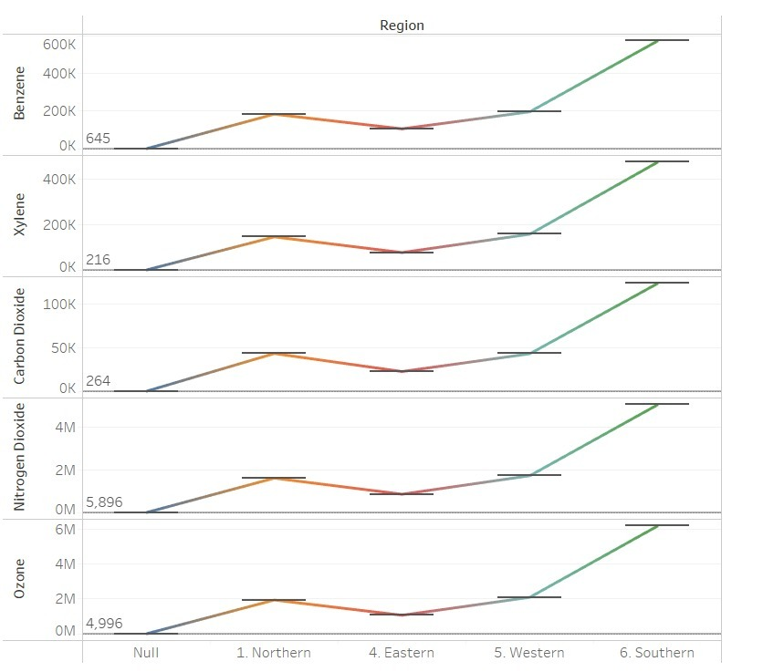
Ques7. How various gases affect various regions?
It can be clearly seen from the graph that numerous gases effect more to southern region than northern part.

Slide 44
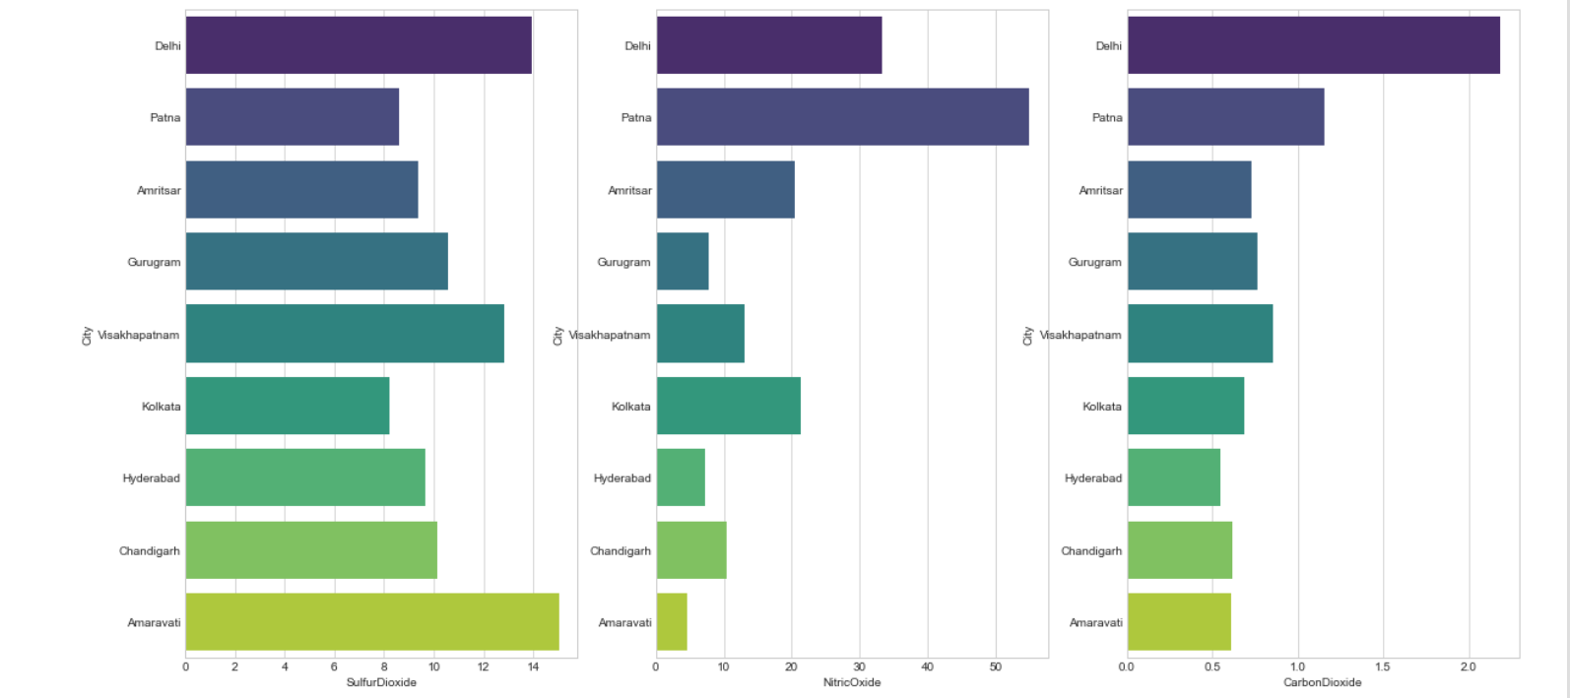
8. The average of different gases in each city?

Slide 45
Description of Graph 8
The city of Patna has the highest average of nitric oxide when compared to Sulphur dioxide and carbon dioxide in the horizontal bar graphs. Furthermore, the average Sulphur dioxide concentration in Delhi and Amaravati exceeds 14, whereas the average nitric oxide concentration in Gurugram and Hydrabad is less than 8. Furthermore, typical carbon dioxide levels in Amaravati and Chandigarh are around 0.5.

Slide 46
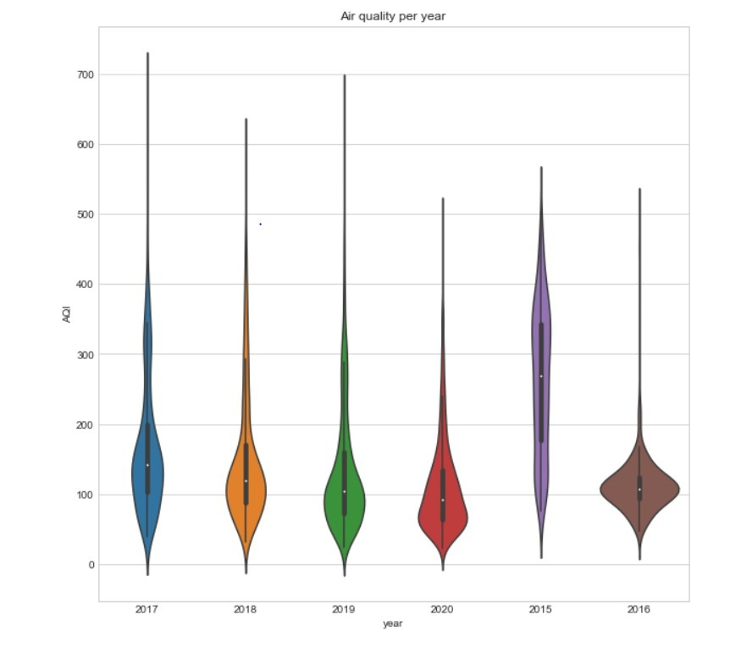
9. Air quality per year

Slide 47
Description of Graph 9
This graph depicts air quality through time; in 2017, air quality was affected by more than 700; on the other hand, the ratio of air quality was relatively low between 2016 and 2020, hovering around 500. Furthermore, in 2015, air quality was 580, with a 60-point difference between 2018 and 2019, when it was 640 and 700.

Slide 48
Reference links:
https://en.wikipedia.org/wiki/Air_pollution
2. https://www.kaggle.com/vaishnavipatil4848/indian-air-quality-analysis
3. https://www.kaggle.com/mitramir5/complete-visualization-analysis-and-predictionhttps://kontext.tech/column/code-snippets/402/pandas-dataframe-plot-pie-chart
4. https://towardsdatascience.com/india-air-pollution-data-analysis-bd7dbfe93841
5. http://seaborn.pydata.org/generated/seaborn.heatmap.html
Acknowledgements
The data is available on the Central Pollution Control Board's website, https://cpcb.nic.in/, which is the government of India's official portal. They also offer an app that monitors air quality in real time: https://app.cpcbccr.com/AQI India/

Slide 49
Conclusion
We examined air pollution issues in this project and created some visuals to show which regions are more polluted by looking at the AQI of different cities and states. For example, the second pie chart shows that summer air pollution was worse than all other seasons, as well as the proportion of air pollution. We have included an illustration of harmful gases and their average levels in cities. From the foregoing research, we can see how major Indian cities such as Delhi, Kolkata, Visakhapatnam, and Patna are disproportionately affected by air pollution and require action to alleviate the situation.

Slide 50
Recommendations
There are a slew of options for dealing with this issue. To get control over this situation, the government needs enact some rules and regulations. People must also adhere to the rules. People should use public transportation instead of driving their own cars to prevent pollution, and they should use reusable and recyclable items. Government should make restrictions to those areas in which are more affected by harmful gases.

Slide 51


